Slide 1
Securing self-virtualizing Ethernet devices
Igor smolyar, muli ben-Yehuda, and dan tsafrir
Presented by luren wang

Slide 2
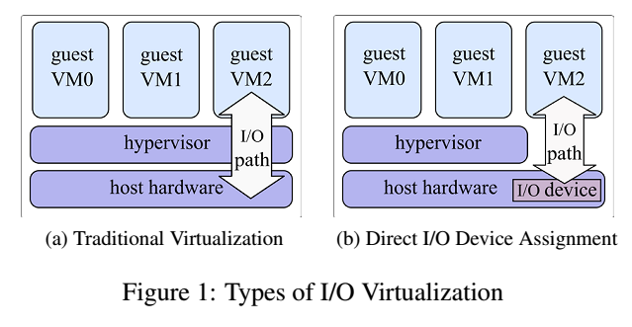
background
Two types of virtualization – Emulation, Direct I/O assignment.

Slide 3
Emulation is scalable but incurs performance costs. For cloud computing where resource usage is money, performance is critical.
Direct I/O is high performance, but not scalable. Modern servers run about 50-100 virtual machines, but only have around 5-10 I/O devices. This is clearly a problem.
Solution : SRIOV

Slide 4
SRIOV
A specification that allows PCIe devices to present itself as multiple virtual interfaces.
Basically, you get the ability to share a single PCIe device as if there were multiple separate physical instances of it.
High performance and scalable.

Slide 5
Specification maintained by PCI-SIG.
Introduces the idea of physical functions (PFs) and virtual functions (VFs).
PFs are full-featured PCIe functions. Discovered, managed, and manipulated like any other PCIe device. PFs have full configuration resources, meaning it is possible to configure and control the device via the PF. Of course, they have the ability to move data in and out of the device.
VFs are “lightweight” functions that lack configuration resources. They also have the ability to move data in and out like PFs. However, they cannot be configure as that would change the underlying configuration of the PF.

Slide 6
Configuration is only possible through the PF. Hence, the OS or hypervisor support is required for SRIOV since the OS or hypervisor instance can properly detect and initialize PFs and VFs correctly.
PCI-SIG SRIOV specifications state that each device can have up to 256 VFs.
Therefore, there is multiple VFs whereas there can only (generally) have one PF. Exceptions, however, include quad-port SRIOV NIC which presents itself as four devices, each having 256 VFs for a theoretical total of 1024 VFs.
Important to keep in mind…these are only theoretical maximums. Practically 64 seems to be the limit.

Slide 8
How is sriov used?
Used in high performance computing, cloud providers (Amazon Elastic Cloud), and data centers.
SRIOV typically results in lower CPU utilization (by up to 50%), lower network latency (by up to 50%), and higher network throughput (by up to 30%) when compared to emulation on Windows Server 2012 Beta.
http://blogs.technet.com/b/privatecloud/archive/2012/05/14/increased-network-performance-using-sr-iov-in-windows-server-2012.aspx

Slide 9
Limitations of sriov
VFs have to be the same type of device as the PF. You cannot, for example, have VFs that present themselves as a different device than the PF. Additionally, as mentioned before, you cannot configure VFs. VFs all rely on the configuration of the PF.

Slide 10
More background…Ethernet control flow
What happens when the sender, for instance an Ethernet switch, transmits data faster than the receiver can process?
Resources like packet buffer memory are expensive. To keep limited resources from being overwhelmed, a variety of flow control mechnanisms were developed.
Ethernet Control Flow is a mechanism that temporarily stops the transmittion of data from the Ethernet when the receiver is full.

Slide 11
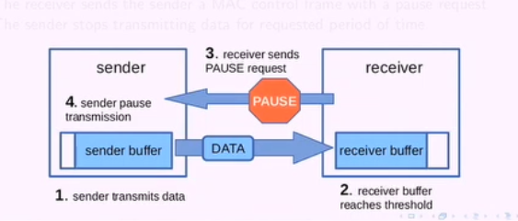
Receiver sends the sender a MAC control frame with a pause request.
This causes the sender to stop transmitting data for the requests period of time needed to for the client to consume resources in the buffer.

Slide 13
Attack vector
Individually, SRIOV and Ethernet are secure. Combined, they are vulnerable to denial of service attacks.
The attack exploits vulnerability in self-virtualizing Ethernet NICs.

Slide 14
Attack mechanism
Same link is shared between all VMs on the machine. Flow control works on the link-layer. Remember that VMs that direct access to VFs of the NIC PF, thus they all have the same configuration.
If a malicious VM sends a pause frame, it will halt traffic on the entire link, thus denying all VMs traffic on the machine.
It is easy to imagine how this malicious VM can cause damage by increasing latency and disrupting services.

Slide 15
Experiment
Set up two servers: one acting as the client and the other as the host with SRIOV enabled NIC.
VF1 of NIC is assigned to VM1 and VF2 is assigned to VM2. Traffic is then generated between VM1 and the client. VM2 then initiates the attack on VM1 by sending pause frames to the Ethernet switch.

Slide 17
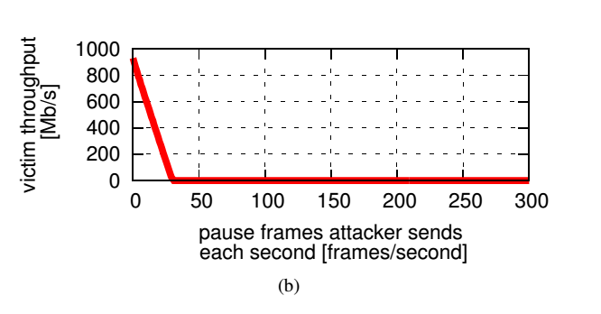
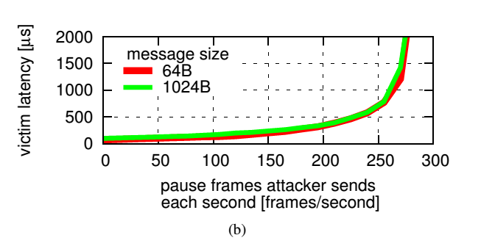

Slide 18
Ramifications
Attack cannot be prevented using filtering capabilities of currently available SRIOV Ethernet devices.
Current SRIOV NICs are only capable of anti-spoofing checks based on the source of the MAC address or the VLAN tag to stop one VM from pretending to be another.
However, this does not affect the attacker from sending pause frames since there is no filter available.

Slide 19
Securing SRIOV
Authors proposed to extend SRIOV Ethernet NIC filtering capability.
Need to filter traffic transmitted by VFs based on MAC destination and Ethernet type fields of the frame (Basically filtering outbound traffic transmitted by the VF).
First need to identify valid pause frames. These are only valid if generated by the NICs’ hardware and have the PF’s source as MAC address. Malicious frames, on the other hand, will have the VF’s address.

Slide 20
PRototype
NIC hardware/firmware are proprietary and closed. Therefore, authors built a Virtualization-Aware Network-Flow controller (VANFC) which is a software prototype of an SRIOV Ethernet with pause frame filtering.
Ethernet switches are replicated with software. Pause frames which have the source address of VFs are filtered out.

Slide 21
Results
Initiated attack with 150 pause frames per second to reduce performance to 50%. VANFC completely blocks the attack and induces no performance penalty.
However, the authors mentioned that software prototype has a delay of 55 nanoseconds which they subtracted from the result since, if implemented in hardware, the filtering speed should be negligible.

Slide 23
Conclusion
SRIOV is incompatible with Ethernet Flow Control. One can argue that flow control is not required for proper functionality of higher level protocols such as TCP, therefore SRIOV can be made self-secure. TCP does have its own flow control mechanisms. However, according to the author, many studies have shown that TCP has high CPU utilization. Therefore, relying on TCP alone will be inefficient. This fact is more crucial in public cloud environments where users pay for computational resources. Higher CPU usage = higher charges.

Slide 24
Quiz
What is SRIOV?
How does VANFC stop denial of service attacks from malicious VMs.
Why don’t malicious VMs simply spoof its own address to that of the PF’s address in order to circumvent VANFC?

